Slide 1
Clustering Cryptocurrencies by Behavioral Patterns
Data Science and Machine Learning: ML Group 10
Unsupervised Learning to Uncover Hidden Market Structures
Aya Abu Allan Anitha Aravindaraman Puneet Arora Tom Konikkara Xavier Redhead
Notes:
Hi everyone, we're Group 10, and today we'll walk you through how we used unsupervised learning to find hidden structure in the crypto market by clustering coins based on their behavior, not just price.

Slide 2
What is Crypto?
‘Crypto’ are digital currencies in which transactions are verified and records maintained by a decentralized system using cryptography, rather than a centralized authority.
More traditional financial institutions are starting to include dedicated crypto trading desks (Goldman Sachs), custody solutions (BNY Mellon) and blockchain pilot programs.
Digital assets expected to become more and more integral to the global financial landscape
Governments are introducing regulatory frameworks (E.U. MiCA, U.S. GENIUS Act signed July 18, 2025)
Notes:
Let’s start with the basics. Crypto refers to digital currencies verified through cryptography rather than central banks. With institutions like Goldman Sachs and BNY Mellon getting involved, it's clear that crypto is becoming part of the mainstream financial system.

Slide 3
Motivation
Crypto market is vast, volatile, unstructured
Thousands of coins with varying behaviour
Price-based grouping is misleading
Investors and researchers would benefit from behavioural groupings similar to what is done for conventional asset classes
Notes:
The crypto market is huge and chaotic, there are thousands of coins, but most behave differently. Price alone doesn’t give the full picture. We wanted to group coins based on how they actually behave, just like how traditional finance uses risk profiles.

Slide 4
As of 2024, over 23,000 cryptocurrencies exist—but more than 80% have little to no active trading volume or utility.
(Source: CoinMarketCap, archived data)
Notes:
To show you just how noisy this market is: there are over 23,000 cryptocurrencies as of 2024, but more than 80% are barely traded or used. That’s why we need smarter ways to segment this space.

Slide 5
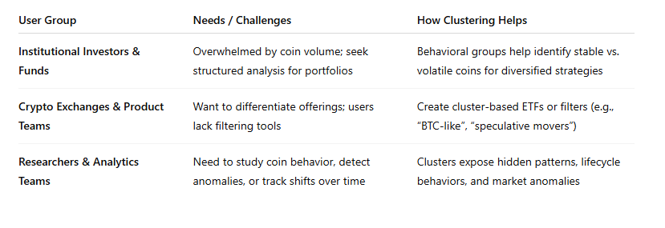
Business Use Cases
Notes:
Our findings can support investors, exchanges, and risk analysts. By understanding which coins behave similarly, you can make better portfolio decisions, detect market shifts, or tailor crypto products.

Slide 6
Dataset Overview
Kaggle - All Cryptocurrencies by JesseVent
~1,584 unique coins across ~620,000 records
Time range: Apr 2013 – Nov 2018
Included features: open, high, low, close, volume, market, close_ratio, spread
Notes:
We used a Kaggle dataset that included data on over 1,500 coins from 2013 to 2018. Each entry included prices, volume, and market data. That gave us a good base to build behavioral profiles.

Slide 7
Feature Engineering
Added features include: daily return, volume change, simple moving average, exponential moving average, relative strength index, average true range, drawdown, etc.
Notes:
We engineered new features like daily return, moving averages, RSI, and volatility measures. This allowed us to capture the true behavioral patterns, not just raw prices.

Slide 8
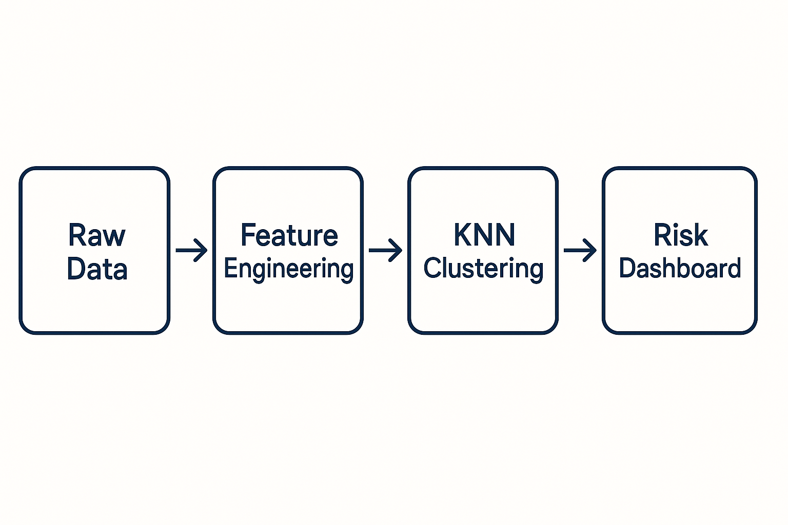
The road from raw data to risk profiles
Process historical price and technical data for 100+ coins across time windows
Extract additional signals: volatility, spreads, momentum, liquidity
Optimize coins into risk-based clusters using unsupervised learning methods
Evaluate cluster relevance
Notes:
We analyzed over 100 coins, pulling out signals like volatility, momentum, and liquidity. Then we used unsupervised learning to group them by risk behavior—not just price or popularity.

Slide 9
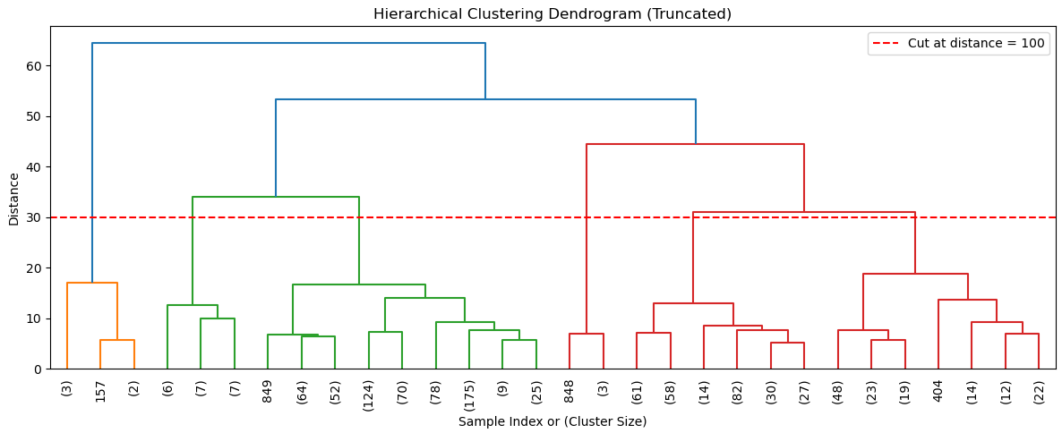
Cluster Interpretation
K-Nearest Neighbour (KNN) algorithm ended up being selected
Choice of K chosen by combination of methods: elbow, silhouette and dendrogram
Notes:
We tested several clustering methods. Ultimately, we chose K-Nearest Neighbours with the number of clusters guided by elbow curves, silhouette scores, and dendrograms. I’ll now pass it over to Xavier, who’ll walk us through what those clusters actually look like and what insights we uncovered.

Slide 10
Distinct Crypto Risk Profiles Emerge
Example:
🟢 Low Risk / High Market Cap / Low Return Stable, established assets with steady price action.
🟠 Medium Risk / Volatile but Promising, altcoins with momentum Upside potential with moderate turbulence.
🔴 High Risk / Spiky Microcaps Erratic price jumps, low liquidity
🔵 Medium Risk / Negative Return Not highly volatile, but underperforming over time.
🟣 Medium-High Risk / High Volatility / Positive Return Higher swings, but signs of consistent upside.
🟤 Low Risk / Illiquid & Flat Return
Quiet assets with little movement or investor interest
Notes:
-From the clustering risk-profiles emerge.
-These risk buckets group coins with similarity of traditional indicators and largely can be placed from low, medium to high risk.
-The clustering algorithm isn’t making predictions but rather is building a mapping of the crypto coins.
We found that some coins stayed in the same risk group consistently, while others jumped categories over time, highlighting the dynamic nature of the market, but also some underlying structure.
grouping, risk buckets, similarity.
"We’re not predicting the weather; we’re building a climate map of crypto assets."
"Some coins are like blue-chip stocks, others behave like lottery tickets."

Slide 11
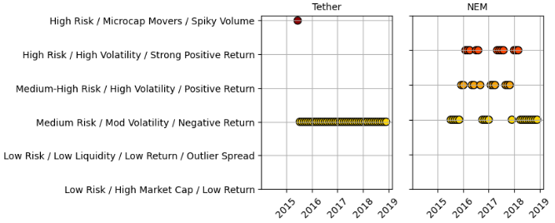
Coin behaviour over time
As expected with cryptocurrencies many switch risk categories
Some coins remained stable while others jumped risk clusters rapidly and repeatedly
Evaluate clusters based on coins in known categories: stablecoin, layer-1, DeFi, Meme
Notes:
-As to be expected with cryptocurrencies, many are in higher risk categories and many switch risk categories over time due to rug pull schemes, meme status or lack of demonstrated utility.
-One way to evaluate the appropriateness of our clusters is to compare the given risk profiles over time for coins that fall in known categories.
-For example, stablecoins are expected to be of lower volatility and “sticky” within their particular risk profile.

Slide 12
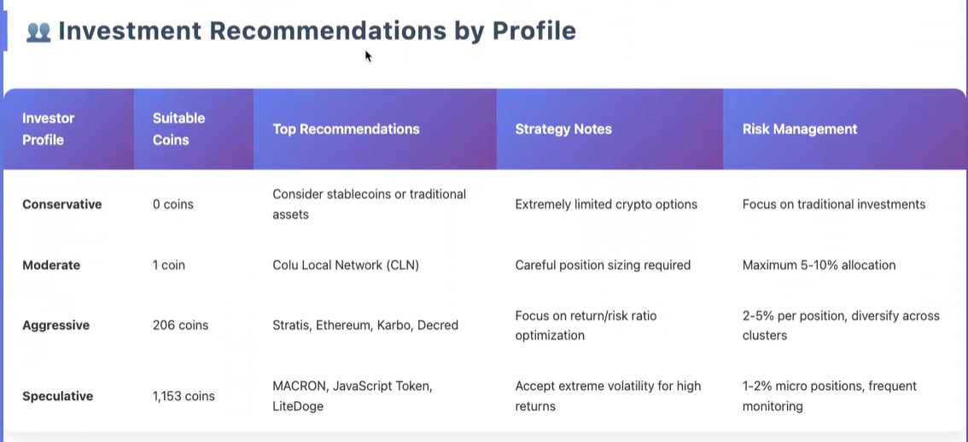
Notes:
-Example for our business case. Financial institutions offers investments advice have a Know-Your-Client (KYC) obligation and fiduciary duty where not assessing client risk profile may lead to liability concerns.
-Unsurprisingly, due to the volatility of cryptocurrencies, none fall within the traditional conservative risk profile.
-For the typical retail investor, this asset class have few coins that truly could be recommended for those with conservative or moderate risk appetites.

Slide 13
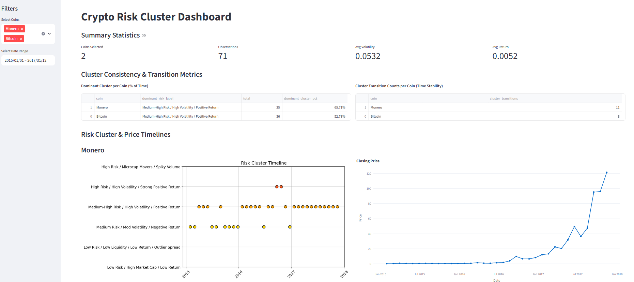
Notes:
-An interactive dashboard was created using the the streamlit python library to allow analyst to screen for stable coins, compare performance between coins, and compare current and historical risk profiles.
-The goal would be to explore ways to maximize risk-adjusted returns for clients.

Slide 14
Challenges and Potential Improvements
No ground truth/ lack of domain knowledge
Nature of market to follow favoured coins
Add more recent data through API
Greater functionality and analysis to dashboards
Deeper dive into other clustering algorithms: DBSCAN, Agglomerative, HDBSCAN
Train classifier using our risk profile labels for new coins/time windows.
Notes:
A few things we’d improve:
Perform a more deeper dive into other clustering algorithms (tinkered with DBSCAN but there are others)
Pull more recent data and perhaps stream data from an API
Use cluster labels to train a KNN classifier (and compare compare to other classifiers like logistic regression, decision trees, random forest)
This could apply labels to new coins or future time windows

Slide 15
What this means for you
Risk aware screening = better asset allocation
Track changing behavior = identify pump & dump or breakout
Understand liquidity + volatility together—not just price action
Notes:
-Risk screening is relevant and important for portfolio constructions especially as crypto becomes regulated and traditional financial institutions enter the space.
-Tracking that risk over time may help identify rug pulls or breakouts.
-Risk allows understanding liquidity and volatility and not just price movement

Slide 16

Despite crypto's reputation for chaos, our clustering analysis uncovered clear, repeatable behavioral patterns across 1,600+ coins.
Key takeaway
Coins often remain within stable risk profiles over time, showing distinct differences in volatility, return, and Sharpe ratios.
This proves that meaningful structure exists beneath the noise, structure that can guide better investment, product design, and risk management decisions.
Notes:
-In short, our clustering revealed that despite volatility of crypto markets there are behavioural patterns and these can be used to make smarter, data-driven decisions.

Slide 17

Thanks!
Any questions?
Notes:
Thanks for listening—happy to take any questions!
-I would like to acknowledge the other 3 members of our team: Tom, Puneet and Aya.
-Best of luck to everyone on the next stages of your data science and/or machine learning journeys

